Slide 1

A Multi-Modal Transformer Architecture Combining Sentiment Dynamics, Temporal Market Data, and Macroeconomic Indicators for Sturdy Stock Return Forecasting
2024 IEEE International Conference on Big Data workshop The IEEE International Workshop on Large Language Models for Finance
Authors:
Abhishek Joshi, Computer Science, Texas A&M University-Corpus Christi
Jahnavi Krishna Koda, Data Science, Texas A&M University-Corpus Christi
Gurojaspreet Kaur, Computer Science, Chandigarh University

Slide 2
Introduction
Challenges in Stock Market Prediction:
Key Limitations of Traditional Models:
Proposed Solution:
Integrate graph neural networks (GNNs) with sentiment analysis and dynamic graph representations to improve predictive accuracy.
Markets are inherently dynamic and influenced by multiple factors like economic indicators, investor sentiment, and sectoral interdependencies.
Heavy reliance on historical data.
Neglect of inter-stock and inter-sector relationships.
Poor performance in turbulent markets.
Traditional models such as ARIMA and GARCH fail to account for these complexities.

Slide 3
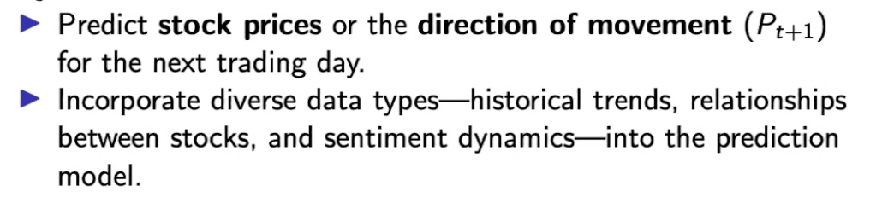
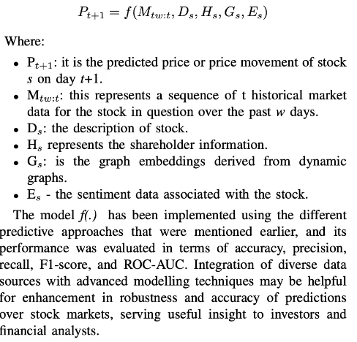
Problem Statement
1
Objective:
2
Mathematical Formulation:

Slide 4
1
Core Problem:
Traditional models often fail to:
Incorporate multi-dimensional data: Temporal (historical trends), relational (inter-stock dependencies), and qualitative (sentiment analysis) features.
Model complex relationships dynamically: Static graphs cannot adapt to rapidly changing market conditions.
Address non-linear and interdependent market behavior: Stock prices are influenced by macroeconomic indicators, sector-wide trends, and investor sentiment, which interact in non-linear ways.
2
Expanded Problem Formulation:
Our task is to develop a predictive model that:
Integrates dynamic graphs to reflect evolving stock relationships.
Captures temporal dependencies from historical data.
Leverages sentiment analysis to incorporate qualitative market signals.
Outputs accurate stock price predictions or directional movement forecasts.

Slide 5
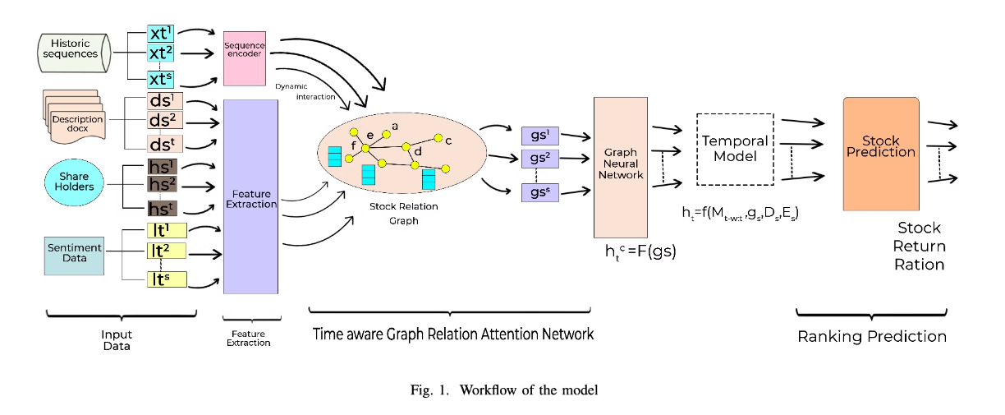
Proposed Framework
Dynamic Graph Construction:
Integration of Sentiment Analysis:
Advanced Graph-Based Models:
Nodes: Represent individual stocks.
Extract data from financial news and discussion forums.
Temporal Graph Networks (TGNs): Capture evolving stock relationships.
Edges: Formed based on:
Industry classification and market capitalization similarity.
Calculate bullish/bearish sentiment scores.
Graph Attention Networks (GATs): Assign importance weights to relevant connections.
Shared institutional holders.

Slide 6
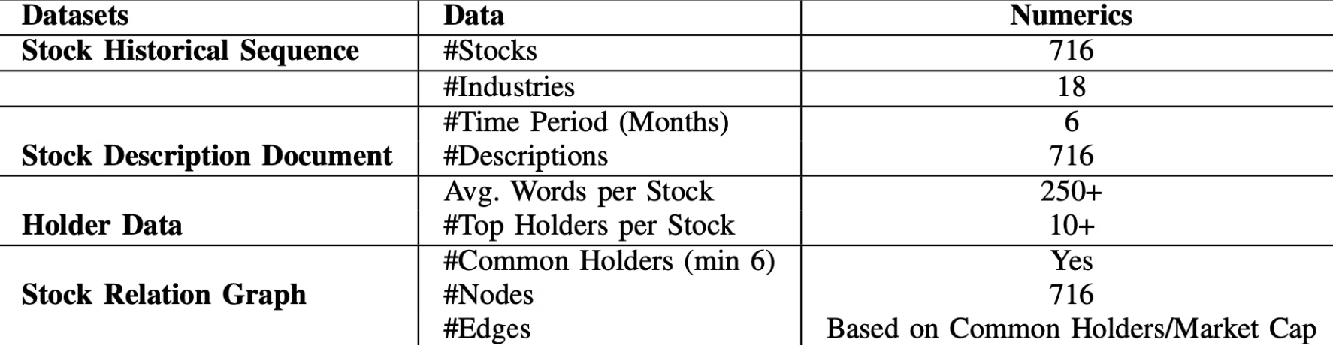
Data Collection and Preprocessing
Dataset Details:
Sentiment Data:
Preprocessing Steps:
Stocks: 716 technology sector stocks across 18 industries.
Source: Extracted from the Yahoo Finance Community Section.
Handling Missing Values: Applied linear interpolation to fill missing data points.
Historical Market Data: Six months of daily OHLC prices, adjusted close prices, and trading volume.
Timeframe: Data collected from February 29, 2024, to June 26, 2024.
Normalization: Used min-max scaling for feature range consistency.
Stock Descriptions: Detailed textual descriptions providing context about company operations.
Processing: Comments and discussions were analyzed for sentiment scores.
Categorical Variable Encoding: Encoded sector and industry variables using one-hot encoding.
Institutional Holder Data: Information on the top institutional holders for each stock.
Output: Sentiment data aligned with historical stock prices for integration into the model.
Sentiment Alignment: Merged sentiment scores with historical price data for dynamic graph construction.

Slide 7
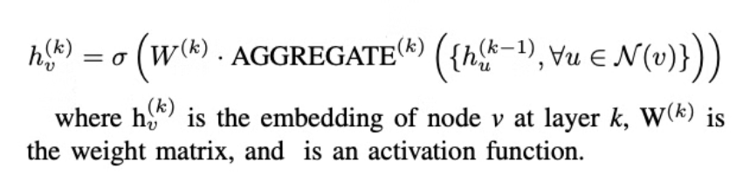
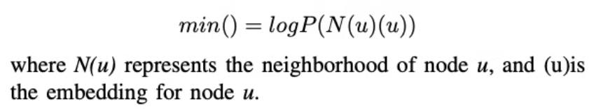
Node Embedding Techniques
Node2Vec: Random Walk-Based Node Embeddings
GraphSAGE: Aggregation-Based Node Embeddings
Overview:
Overview:
Node2Vec generates node embeddings by simulating random walks on the graph.
GraphSAGE generates embeddings by aggregating features from a node’s local neighborhood.
It optimizes the embedding to preserve neighborhood structures (homophily and structural equivalence).
It allows inductive learning, enabling predictions for unseen nodes.
Key Features:
Key Features:
Aggregates information from neighboring nodes through functions like mean, LSTM, or pooling.
Supports biased random walks, which balance breadth-first and depth-first search strategies.
Produces embeddings by stacking layers of aggregation.
Captures both local and global structural relationships.
Mathematical Representation:
Mathematical Objective:
Advantages for Stock Market Prediction:
Advantages for Stock Market Prediction:
Captures connections based on shared holders or industries.
Integrates temporal, relational, and sentiment data.
Identifies stocks with similar patterns within their local and global neighborhoods.
Effective in capturing complex interdependencies, such as industry-wide trends or mutual fund holdings.

Slide 8


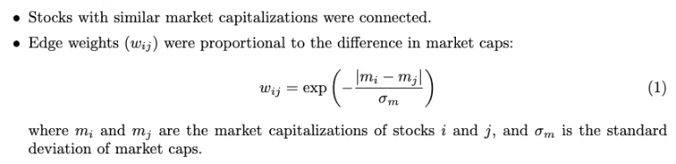

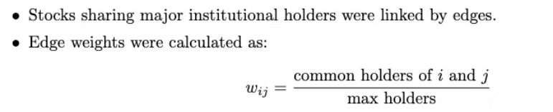
Experimental Setup
Graph Construction: Dynamic graphs were created to capture relationships among stocks based on three key criteria:
Industry Classification:
Stocks in the same industry were connected by edges. These edges capture sectoral trends and shared dependencies within industries.
Market Capitalization Similarity:
Common Institutional Holders:
Stocks sharing major institutional holders were linked by edges. Edge weights were calculated as: 𝑤𝑖𝑗 = common holders of 𝑖 and 𝑗 / max holders

Slide 9
Sentiment Analysis Integration: Sentiment data was incorporated to reflect investor sentiment from online platforms:
1
Source:
2
Timeframe:
Extracted from the Yahoo Finance Community Section.
Data collected between February 29, 2024, and June 26, 2024.
3
Processing:
4
Alignment:
Text data was preprocessed using tokenization, stop-word removal, and lemmatization. Sentiment scores were computed using a sentiment analysis tool, quantifying bullish and bearish tones for each stock.
Sentiment scores were synchronized with historical stock prices and trading days for accurate temporal alignment.
5
Dataset Composition:
6
Preprocessing Steps:
Key statistics of the dataset include:
Handling Missing Data: Missing values in stock prices were filled using linear interpolation to maintain consistency.
Number of Stocks: 716
Industries: 18
Normalization: Features like stock prices, trading volume, and sentiment scores were normalized using min-max scaling to standardize the range.
Time Period: 6 months
Avg. Words per Stock Description: 250+
One-Hot Encoding: Industry and sector data were encoded to include categorical variables in the graph construction.
Number of Common Holders Min: 6
Sentiment Period: Feb 29 - Jun 26, 2024
Edge Weight Calibration: Weights for graph edges were standardized to ensure all edge attributes could be effectively interpreted by the model.

Slide 10
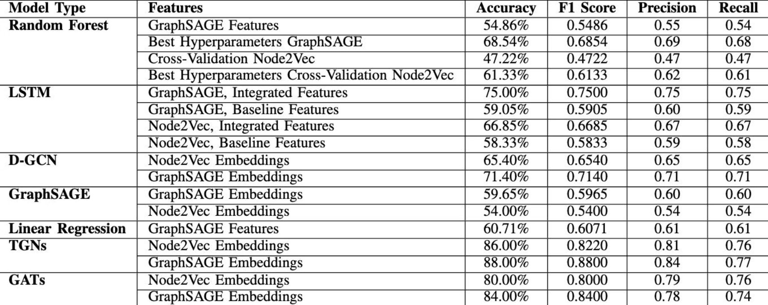
Models Used And Results

Slide 11
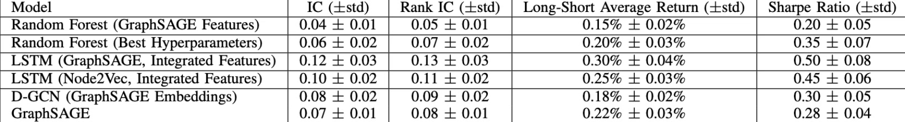
Financial Performance Metrics
Metrics:
Information Coefficient (IC): Correlation between predicted and actual returns.
Rank IC: Spearman rank correlation for predictions.
Sharpe Ratio: Risk-adjusted return measure.

Slide 12
Conclusion
Advanced graph-based models, like TGNs and GATs, outperform traditional approaches.
Sentiment integration improves adaptability and robustness.
Future work: Incorporate real-time sentiment data and hybrid modeling techniques.

